Slide 1

G H RAISONI INSTITUTE OF ENGINEERING & TECHNOLOGY, PUNE

Slide 2
T
I
T
L
E
PRECISION AGRICULTURE USING
ML & IOT

Slide 3
BE- COMPUTER ENGINEERING
GROUP MEMBERS:
VENKATANARAYANA BOMMANABOINA
ATHARVA LABHASETWAR
KUNDAN PATIL
PROJECT GUIDE : Mrs. RACHANA SABLE

Slide 4
CONTENTS
Introduction to Precision Agriculture
Objectives
Problem Statement
Literature Survey
System Architecture and Methodologies
Software and Hardware Requirements
Data Flow Diagrams
Algorithms & Accuracy
Advantages
Conclusion
References

Slide 5
Introduction
WHAT IS PRECISION AGRICULTURE ?
Precision agriculture is a modern farming technique that uses research data of soil characteristics, soil types, crop yield data collection.

Slide 6
Objective
To build a robust model to give a correct and accurate real-time prediction of crop in a given state for the particular soil type and climatic conditions.
To provide recommendation of the best suitable crops in the area so that farmers do not incur any loss.

Slide 7
Problem Statement
The common problem existing among the Indian farmers are they don’t choose the right crop based on their soil requirements and also which fertilizer to be used for their crop.
This problem of farmers has been addressed through precision agriculture.

Slide 8
Literature survey
Ref. no. | Year | Paper name | Feature Selection | Highest Accuracy
1 | 2021 | Intelligent Crop Recommendation System using Machine Learning | Decision Tree, KNN, Logistic Regression, SVM, Naive Bayes, Neural network | 95.00%
2 | 2020 | Classification of Soil and Crop Suggestion using Machine Learning Techniques. | KNN, Logistic Regression, Bagged tree, SVM | 91.09%
3 | 2020 | Crop Prediction Method to Maximize Crop Yield Rate Using Machine Learning Techniques | KNN, Naïve Bayes, Random Forest, K-star | 97.00%
4 | 2020 | Soil Analysis and Crop prediction | Naïve Bayes, Logistic Regression, Decision Tree | 89.00%
5 | 2019 | Crop Recommendation System for Precision Agriculture | SVM, Random Forest, KNN, Bagging Technique And Naïve Bayes | 90.75%
6 | 2018 | Soil Classification Using Machine Learning Methods and Crop Suggestion Based on Soil Series | Gaussian SVM, Weighted KNN, Bagged trees | 91.16%
7 | 2018 | A Review on Data Mining Techniques for Fertilizer Recommendation | Clustering, Decision Tree, SVM | 87.86%

Slide 9
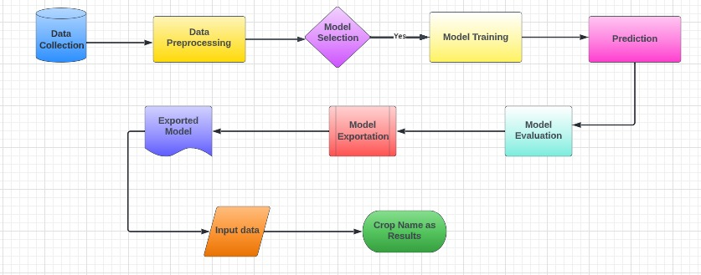
System Architecture

Slide 10
Methodologies
This system architecture involves in series steps given below :
* Data Collection using IOT
* Data Preprocessing
* Train/Test Split
* Model Selection
* Model Training
* Prediction
* Model Evaluation
* Model Exportation/Deployment

Slide 11
Software & Hardware Requirements
Hardware System Configuration:
Processor: 2 gigahertz (GHz) or faster processor.
RAM: 4 gigabyte (GB) for 32-bit or 4 GB for 64-bit.
Hard disk space: =>16GB.
Software Configuration:
Operating System: Windows XP/7/8/8.1/10, Linux and Mac
Coding Language: Python
Tools: Pandas, Numpy ,Seaborn , Pickle,Scikit-learn, Pytorch & ResNet
Framework: Flask
Other Tools : HTML, CSS, Bootstrap

Slide 12
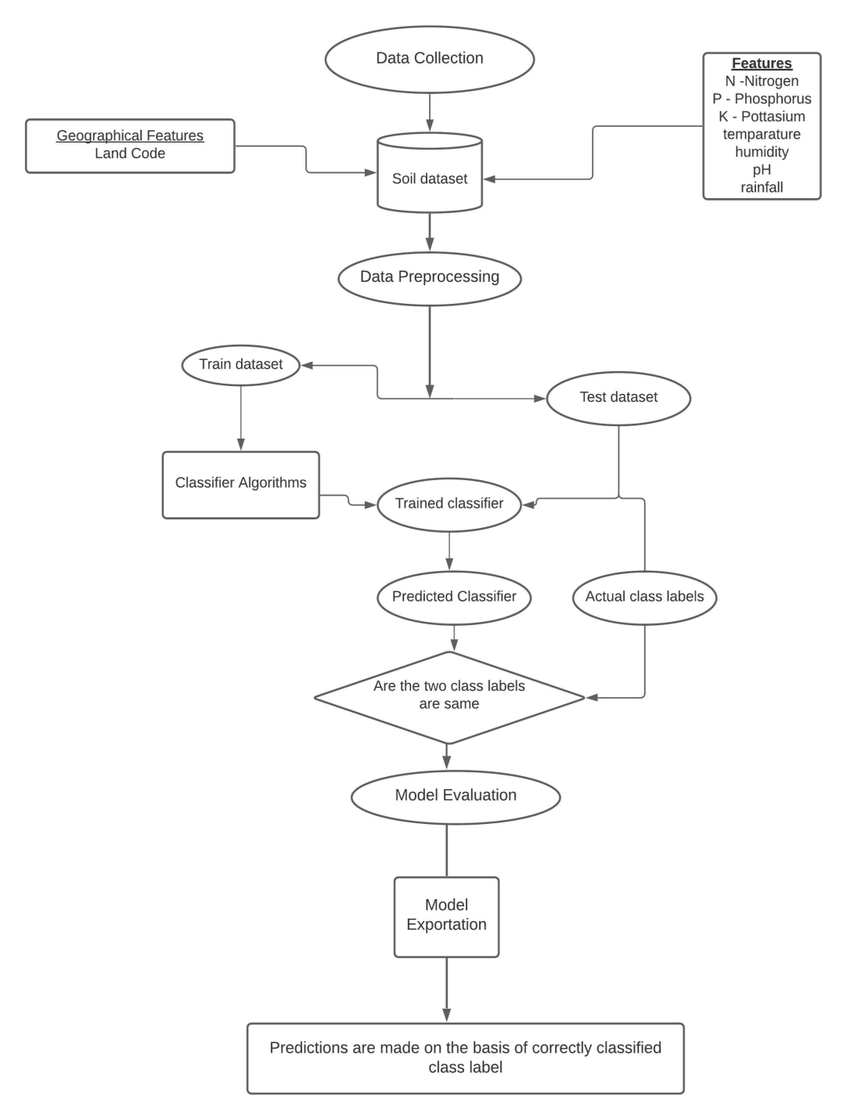
Data Flow Diagram

Slide 13
Algorithms & Accuracy
We used a series of ML algorithms such as
Algorithm | Accuracy (%)
Decision Tree | 90%
SVM | 97%
Logistic Regression | 95%
Random Forest | 99%

Slide 14
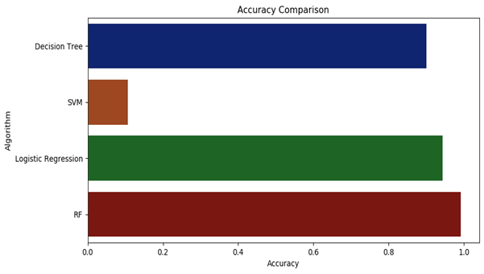
Accuracy Comparison
Hence, Random Forest is our Final efficient model

Slide 15
Advantages
Improve farm management efficiency by adjusting field/crop treatments
Ensure profitability, sustainability and protection of the environment.
Optimise efforts and resources, reduce consumption and waste, and boost land productivity.

Slide 16
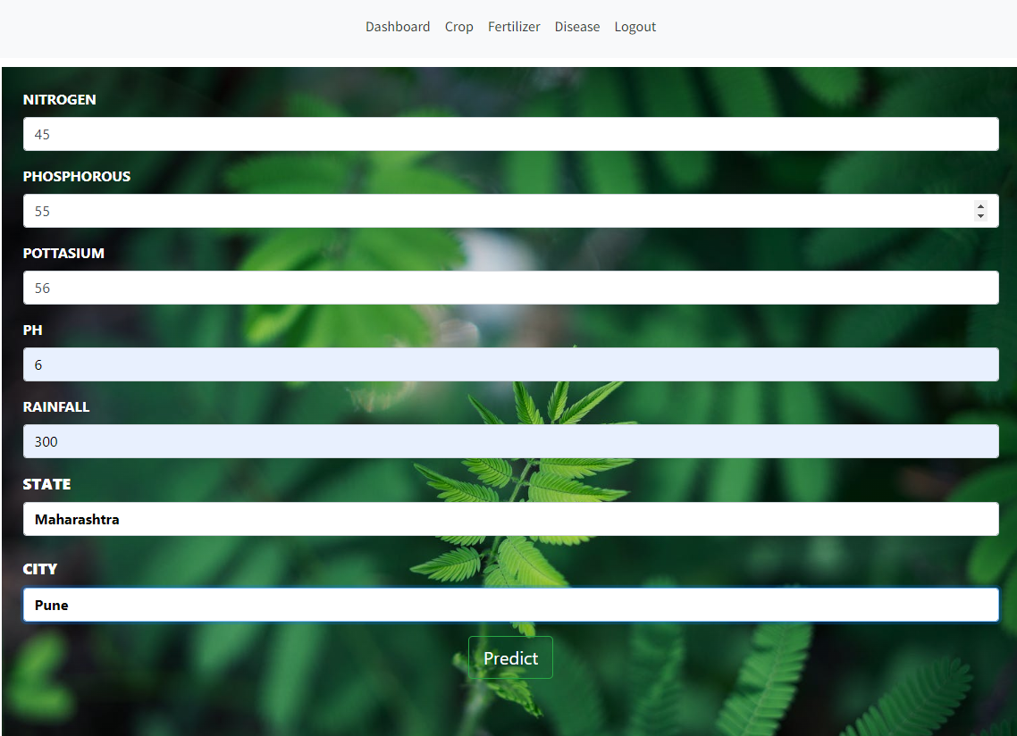
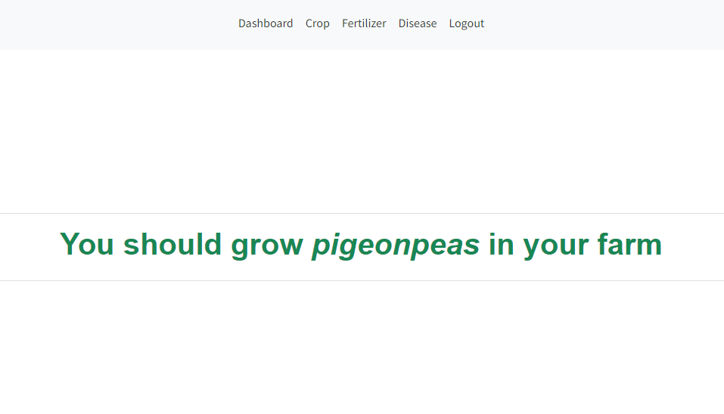
Results
According to nutrients of Soil you will get output as best crop that
you should grow on your farm

Slide 17
Conclusion:
Thus, our work would help farmers in sowing the right seed based on soil requirements to increase productivity and acquire profit out of such a techniques.
Our future work is aimed at an improved data set with large number of attributes and also implements yield prediction.

Slide 18
References
[1] 2019, 10th International Conference on Computing, Communication and Networking Technologies, “Low-cost IOT+ML design for smart farming with multiple applications”, Fahad Kamraan Syed, Agniswar Paul, Ajay Kumar, Jaideep Cherukuri.
[2] 2019 IEEE “ Smart Management of Crop Cultivation using IoT and Machine Learning” Archana Gupta, Dharmil Nagda, Pratiksha Nikhare, Atharva Sandbhor
[3] Radhika, Narendiran, “Kind of Crops and Small Plants Prediction using IoT with Machine Learning,” International Journal of Computer & Mathematical Sciences, 2018.
[4] “Crop Recommendation on Analyzing Soil Using Machine Learning” Anguraj.Ka, Thiyaneswaran.Bb, Megashree.Gc, Preetha Shri.J.Gd, Navya.Se, Jayanthi. Jf, 2020.
[5] “Classification of Soil and Crop Suggestion using Machine Learning Techniques”, A. Mythili , IEEE 2019.
[6] Mehta, P., Shah, H., Kori, V., Vikani, V., Shukla, S., & Shenoy, M.,2018. “Survey of unsupervised machine learning algorithms on precision agricultural data”, IEEE
[7] “IOT based Crop Recommendation, Crop Disease Prediction and Its Solution” Rani Holambe, Pooja Patil, Padmaja Pawar, Saurabh Salunkhe , Mr. Hrushikesh Joshi, 2019 IRJET

Slide 19
THANK YOU

